Slide 1
Genetic Algorithm Continued

Slide 2
Working of GA
An individual in a population corresponds to a particular solution
After reproduction, GA generates another population which probably contains an improved solution
Iterative searching technique
Working cycle with/without convergence
Solution is not necessarily guaranteed. Usually, terminated with a local optima

Slide 3
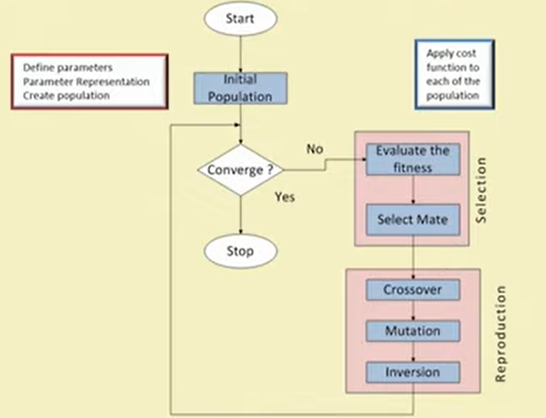
GA Framework: A Detailed View

Slide 4
Optimization Problem Solving with GA
For optimization problem, identify the following:
Objective function
Constraint(s)
Input Parameters
Fitness evaluation (it may be an algorithm or a mathematical expression)
Encoding
Decoding

Slide 5
GA Operators
Encoding: How to represent a solution?
Convergence: Deciding the termination criterion.
Mating Pool: Generate future solutions
Fitness Evaluation: Evaluate a solution
Crossover: Getting diverse set of solutions
Mutation: Explore other solutions
Inversion: To move from one optima to the other

Slide 6
Different GA Strategies
Simple Genetic Algorithm
Steady State Genetic Algorithm
Messy Genetic Algorithm

Slide 7
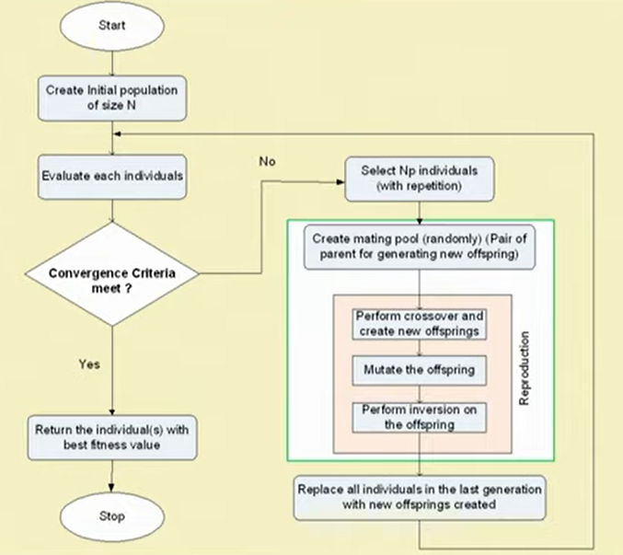
SGA Framework

Slide 8

SGA Parameters
Initial population size: N
Size of mating pool: Np = p% of N
Convergence threshold $δ$
Mutation probability $μ$
Crossover probability $ρ$
Inversion $probability η$

Slide 9
Salient Features in SGA
Have overlapping generation (only fraction of individuals get replaced)
Computationally expensive
Good when initial population size is large
Selection is biased towards highly fitted individuals. Hence, average fitness (of overall population) is expected to increase with iteration
The best individual may appear at any iteration
Multiple individuals in a population can have similar encoding

Slide 10
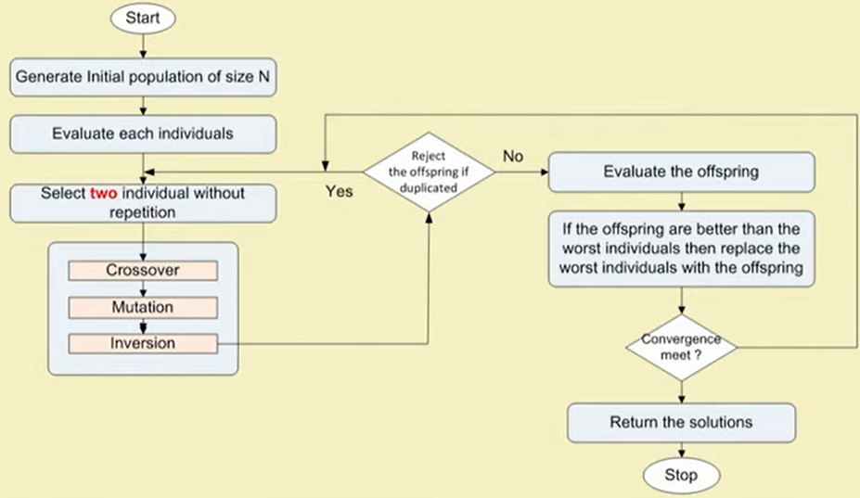
SSGA Framework

Slide 11
SSGA Features
Generation gap is small
Only two offsprings are produced in one generation
Applicable when
Population size is small
Chromosomes are of longer length
Evaluation operation is less computationally expensive

Slide 12
Limitations of SSGA
There is a higher chance to get stuck at local optima, if crossover/mutation/inversion is not strong enough to diversify the population
Premature convergence may occur
Susceptible to stagnation. Inferiors are neglected or removed. We keep on making more trials for very long period of time without any gain (i.e., long periods of localized search)

Slide 13
Encoding Schemes
Binary encoding -> Binary coded GA or simple Binary GA
Real-value encoding -> Real coded GA or simple Real GA
Order encoding -> Order GA or Permuted GA
Tree encoding -> Tree encoded GA
In GA, an individual is a single solution, whereas a population is a set of individuals at an instant of the searching process

Slide 14
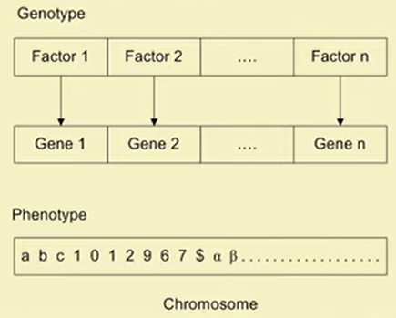
Individual Representation: Phenotype and Genotype
An individual is defined by a chromosome. A chromosome stores genetic information (phenotype) of an individual
In GA, a chromosome is expressed as a set of factors defining a problem

Slide 15
Individual Representation: Phenotype and Genotype
A gene is GA’s representation of a single factor (i.e., a design parameter) which has a domain of values (may be binary, real, alphanumeric, etc.)
There is a mapping from genotype to phenotype which eventually decides the speed and accuracy of problem solving

Slide 16
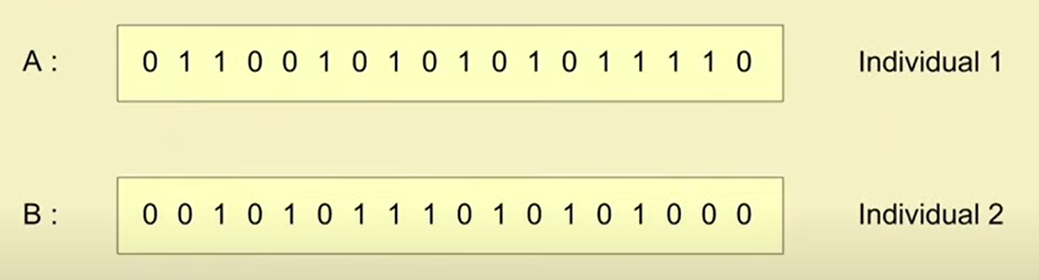
Binary Encoding
In this scheme, a gene (and hence, a chromosome) is represented by a string of 0s and 1s.
The chromosome length is fixed for SGA and SSGA, and variable for Messy GA

Slide 17
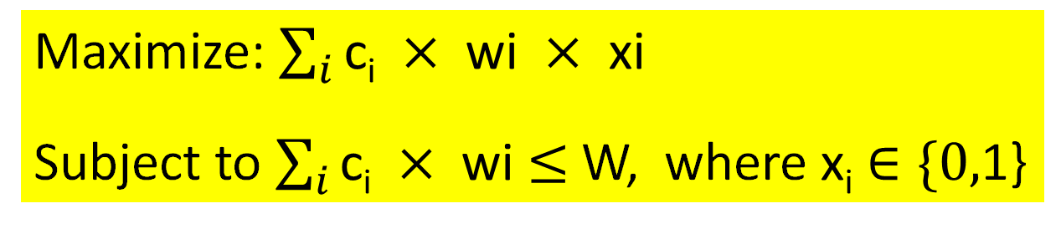
Example: 0-1 Knapsack Problem
There are n items: i^{th} item has its own cost c_{i} and weight w_{i}.
There is a knapsack of total capacity W.
The problem is to take item with maximum value without exceeding the capacity of knapsack.
Formulate the optimization problem:
Maximize: $\sum_{i}{\text{c}\text{i} × \text{wi} × \text{xi}}$
Subject to $\sum_{i}{\text{c}\text{i} × \text{wi}}$ $≤$ W, where $\text{x}\text{i}$ $∈\{0,$1}

Slide 18
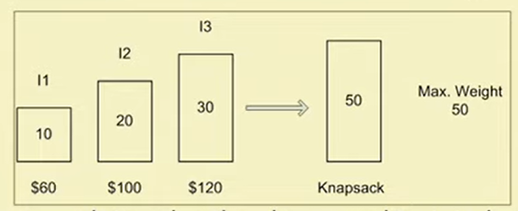
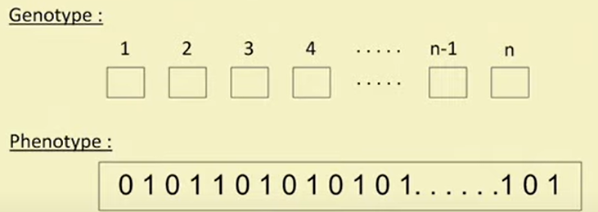
Example: 0-1 Knapsack Problem
Brut-force approach to solve the above is as follows:
We can either select an item or not select an item. Total no. of possibilities is 2^{n}-1
[10], [20], [30], [10,20], [10,30], [20,30], [10,20,30]
Possible binary encoding for the given problem: 1 for selecting, 0 for not selecting
[000], [001], [010], [011], [100], [101], [110], [111]
The encoding of the 0-1 Knapsack Problem for n items would look like:

